Slide 1
Weather forecast using Markov chain
Mentor:
prof. dr. Migdat Hodžić
Student:
Zorka Kunovac

Slide 2
Content:
Introduction
Business understanding and methods
Data understanding
Markov chain
Atmospheric pressure
Results
Demo
Conclusion

Slide 3
Introduction
Weather has changed dramatically
Sudden changes in the weather in just one day
Pressure - meteoropathy
The goal is weather forecasting and determining the impact of weather and weather changes on human health

Slide 4
Introduction
Can a sudden change in the weather affect human health?
Human bodies get used to a certain climate, and when those things change suddenly, the human body has to try to adapt. Unfortunately, sometimes our bodies have a difficult time adjusting, which can trigger an illness
Six main symptoms caused by weather changes :
  Changes in blood pressure
  Headache
  Sleep problems
  Increased number of heart attacks
  Breathing problems
  Weakened immune system

Slide 5
Business understanding and methods
With sudden changes in temperature, atmospheric pressure or humidity, people most often complain of irritability or low and depressed mood
Meteoropathy is a disease of the modern age and is related to the modern way of life
Risk groups: middle-aged and older people, especially women, but also children, people who have mental and behavioral disorders
Older people, people who have had surgery, people whose occupations include prolonged sitting at work and using a computer, may feel symptoms at every change of time
Markov chain

Slide 6
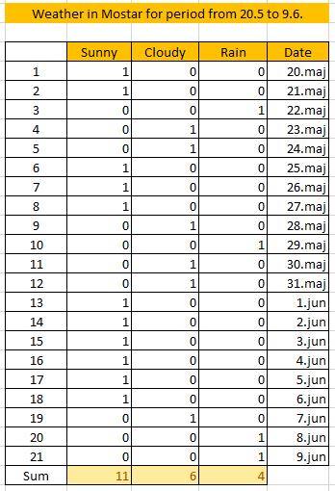
Data understanding
Historical data on actual weather events
Observed period of 21 days, specifically the period from May 20th to June 9th.
Three states were observed: Sunny, Cloudy, Rain
There are questions that were sought to be answered like:
  a) If the system is in the Sunny state, what is the probability that it will stay in the Sunny state on the next observation
  b) If the system is in the Sunny state, what is the probability that it will be in the Cloudy state on the next observation and what is the probability that it will be in the Rain state?
  etc.

Slide 7
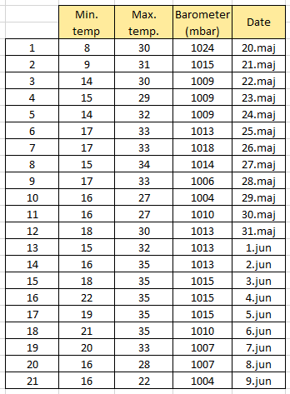
Data understanding
Minimum temperature, maximum temperature and air pressure
Human health is most affected by temperature changes but also atmospheric pressure
Negative impact on health

Slide 8
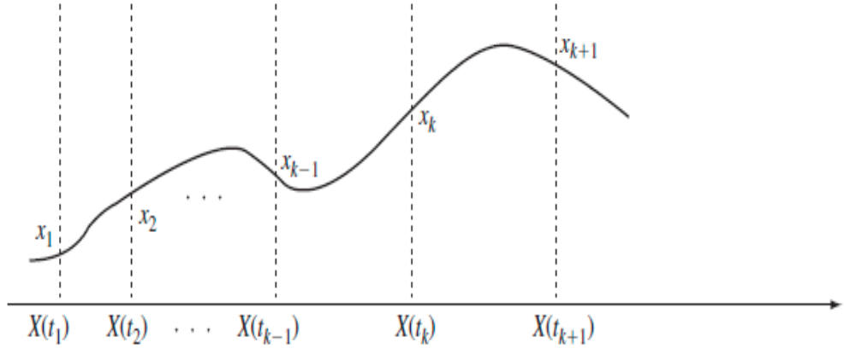
Markov chain
At any time, the system may go into a new state or may remain in the same state
Changes in the state are called transitions
The future states of the process depend only upon the present state, not on the past states leading up to the present state

Slide 9
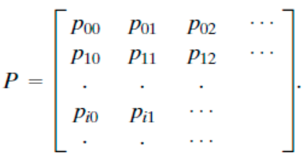

Markov chain
Transition probability matrix
Matrix is called stochastic if :
  All entries are greater than or equal to zero.
  The sum of the entries in any column is one.

Slide 10
Atmospheric pressure
A barometer is a device that reads atmospheric pressure
Few examples of how to interpret barometric readings:
  When the air is dry, cool, and pleasant, the barometer reading rises.
  In general, a rising barometer means improving weather.
  In general, a falling barometer means worsening weather.
  When atmospheric pressure drops suddenly, this usually indicates that a storm is on its way.
  When atmospheric pressure remains steady, there will likely be no immediate change in the weather.
A barometric reading over 30.20 inHg (1022.689 mb) is considered high, and high pressure is associated with clear skies and calm weather
Range of 29.80 and 30.20 inHg (1022.689–1009.144 mb ) is normal - associated with steady weather
Below 29.80 inHg (1009.144 mb) is low - warm air and rainstorms

Slide 11

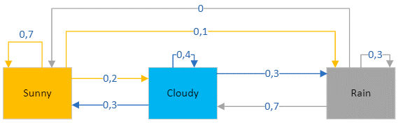
Results
a) The system was in state Sunny in 11 cases. In 8 cases the system remained in the Sunny state.
b) Out of 11 Sunny cases, in 2 cases, the system transitioned from Sunny to Cloudy and in only 1 case to Rain.
c) State Cloudy in 6 cases. In 2 cases the system remained in Cloudy states.
d) Out of 6 cases, in 2 cases the system transitioned from Cloudy to Sunny and in 2 cases to Rain.
e) State Rain in 4 cases. In two cases the system transitioned from Rain to Cloudy and once system remained Rain.

Slide 12
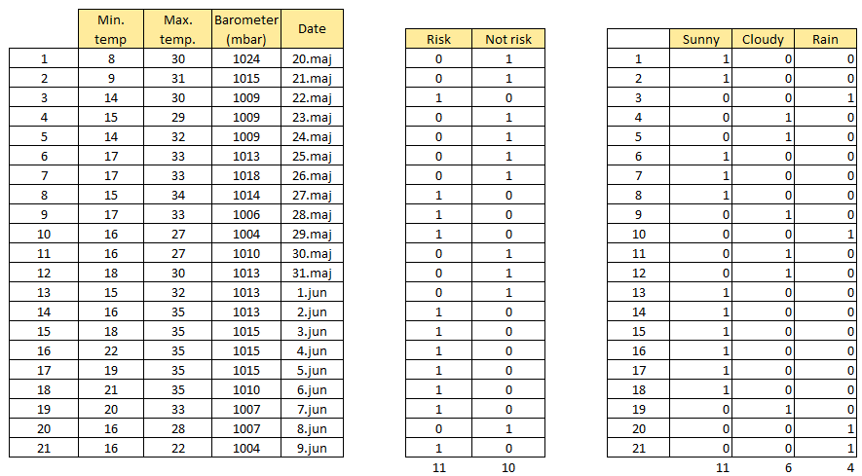
Results
Atmospheric pressure was within 1003–1007 hPa can cause a migraine
Column which are lower and sometimes equal to 1007 mbar are marked as risk for health
Maximum temperature is greater than or equal to 33°C

Slide 13

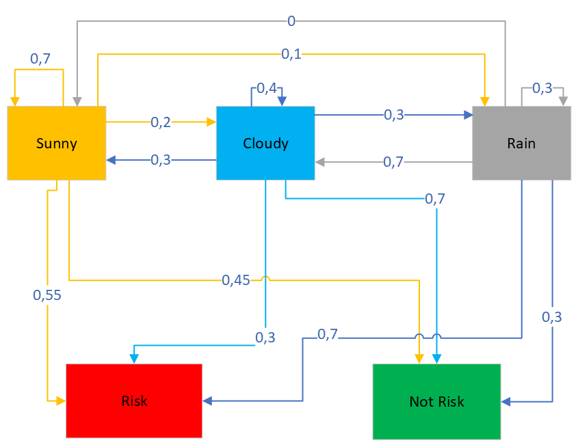
Results
Of the 11 risk cases, 6 had sunny weather, mostly due to high temperatures, 2 cases had cloudy weather and 3 rain.
Of the 10 not risk cases 5 had sunny weather, four had cloudy and one had rain.

Slide 14
Demo

Slide 15
Future work
Weather’s impact on mental health
How people can prepare in advance for the upcoming weather changes
Possibly include humidity and wind speed

Slide 16
Conclusion
Sudden changes in weather, in air pressure and temperature can indeed have huge impact on people physical and mental health.
Greatest health risk is caused by rainy weather (low pressure)
Health problems can also occur when the weather is sunny but only if temperatures are high.

Slide 17
Thanks for watching!
Questions?

